Slide 1
MYOPIA AND HYPERMETROPIA IMAGE DETECTION
COMPUTER SCIENCE AND ENGINEERING

Slide 2


Name of Student | SRN of Student | Semester & Section
MADINENI KAVYA | R21EJ063 | 6-B
OM MISHRA A | R21EJ067 | 6-B
SANJANA B | R21EJ074 | 6-B
SAKSHI UPADHYE | R21E073 | 6-B
Under the Guidance of
Prof. Kasi Viswanath Gupta
Designation:Associate Professor
School of CSE, REVA University

Slide 3
Abstract
Introduction
Technology and Domain
Front End and Back End Details
Literature Survey
Methodology
Dataset
Sample Code and Screenshot of output
Conclusions
Reference

Slide 4
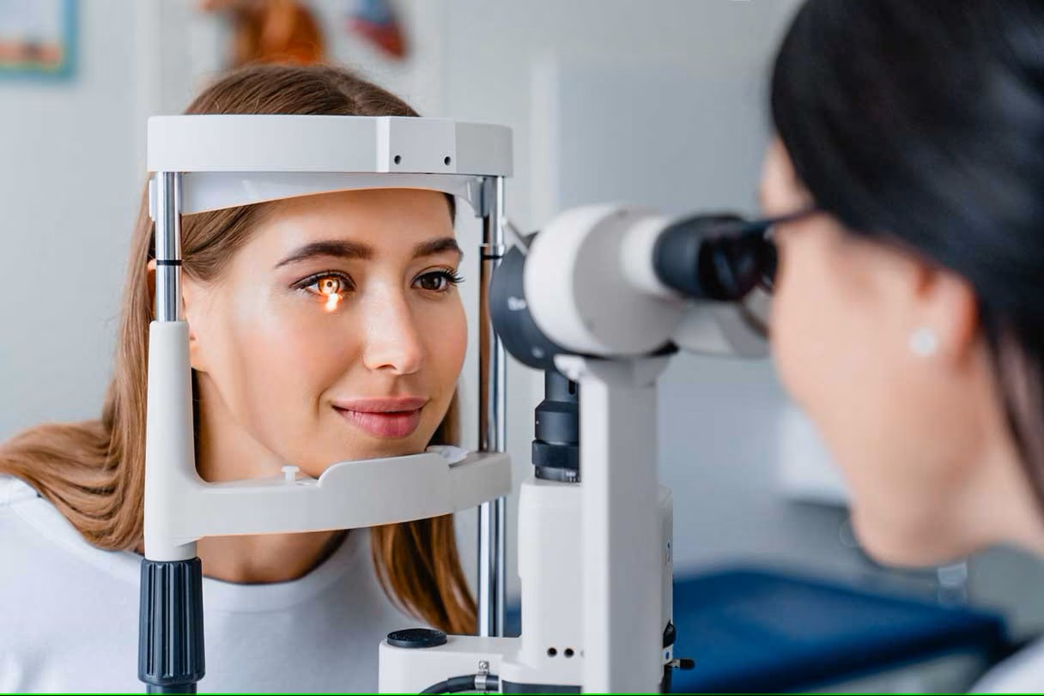
ABSTRACT
This Eye Disease addresses user Eye concerns through a user-friendly application . The system consists of Eye Scanner for Eye after authentication users are navigated to the main page where the users scan there Fundus image and based on the problems, it will provide recommendations that includes images of recommended foods and tailored precautions and dietary guidelines.

Slide 5
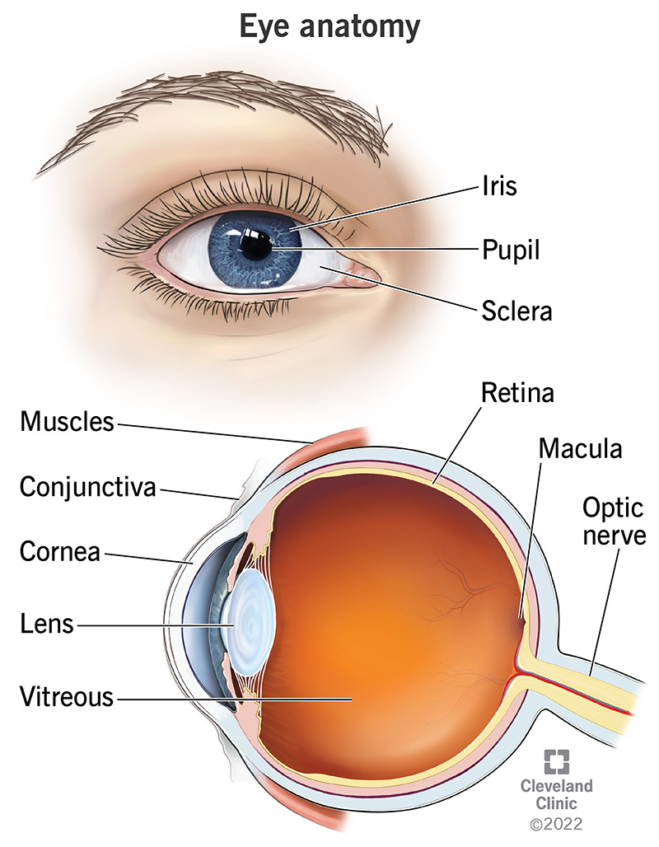
INTRODUCTION
Myopia and hypermetropia are common eye disorders that affect the ability to see clearly at different distances. Myopia, also known as nearsightedness, causes distant objects to appear blurry, while hypermetropia, also known as farsightedness, causes near objects to appear blurry. These conditions are usually caused by the shape of the eye, the curvature of the cornea, or the length of the eye. In the current scenario of the world, People face some of the Eye Sight problems due to some other factors and to overcome the problem the system has been proposed that manages the user related problems.

Slide 6
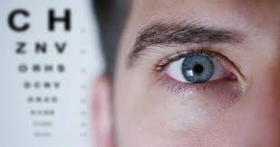
LITERATURE SURVEY
WHY EYE SIGHT OCCUR
AGE RELATED
DIABETIC RETINOPATHY
CATARACT
GLAUCOMA
AMBLYOPIA
STRABISMUS
REFRACTIVE ERROR

Slide 7
Problem statement
Detecting myopia and hyperopia (also known as hypermetropia) from eye images is crucial for early diagnosis and treatment. However, existing image detection methods may lack accuracy or efficiency. The challenge is to develop a simple and effective algorithm that can accurately classify eye images as myopic, hyperopic, or normal. This algorithm should be able to identify subtle differences in the shape and structure of the eye to provide accurate diagnoses, enabling timely intervention and improving patient outcomes.

Slide 8
OBJECTIVES
The objectives of a Eye Sight system typically include:
Optimizing healthcare resources.
Enhancing efficiency and effectiveness of healthcare delivery.
Ensuring with regulations.
Promoting patient safety.
Continuous quality improvement.

Slide 9
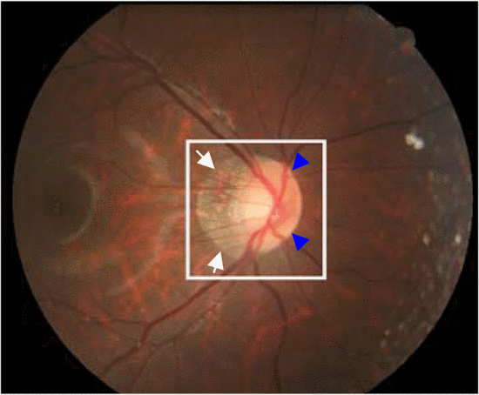
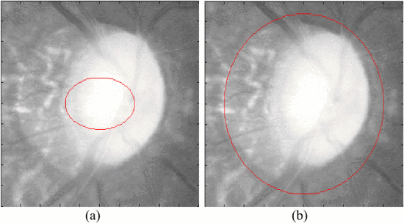
METHODOLOGY
This project proposes a methodology utilizing image processing and machine learning techniques to diagnose myopia and hypermetropia based on eye images.
CNN is mostly used in the field of computer vision particularly in image classification problems.
Extract relevant features from the images that are indicative of myopia or hypermetropia.
Features could include corneal shape parameters, pupil-lens distance, blood vessel patterns, and other relevant characteristics.
Deep learning algorithms like convolutional neural networks (CNNs) are well-suited for image analysis due to their ability to learn complex patterns from data.
Train the model on the labeled dataset, allowing it to learn the relationship between extracted features and the presence/absence of myopia or hypermetropia.

Slide 10
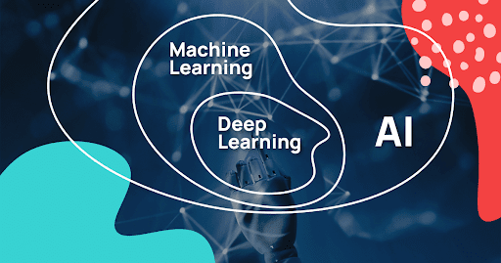
TECHNOLOGY AND DOMAIN
Python is one of the most popular programming languages for machine learning, largely due to its simplicity, versatility, and a vast ecosystem of libraries and tools.
Machine learning is a branch of artificial intelligence (AI) that focuses on developing algorithms and techniques that enable computers to learn from and make predictions or decisions based on data, without being explicitly programmed to do so.
Kaggle is a popular platform for data science competitions, where participants can compete to solve various machine learning problems by analyzing datasets provided by companies and organizations.

Slide 11
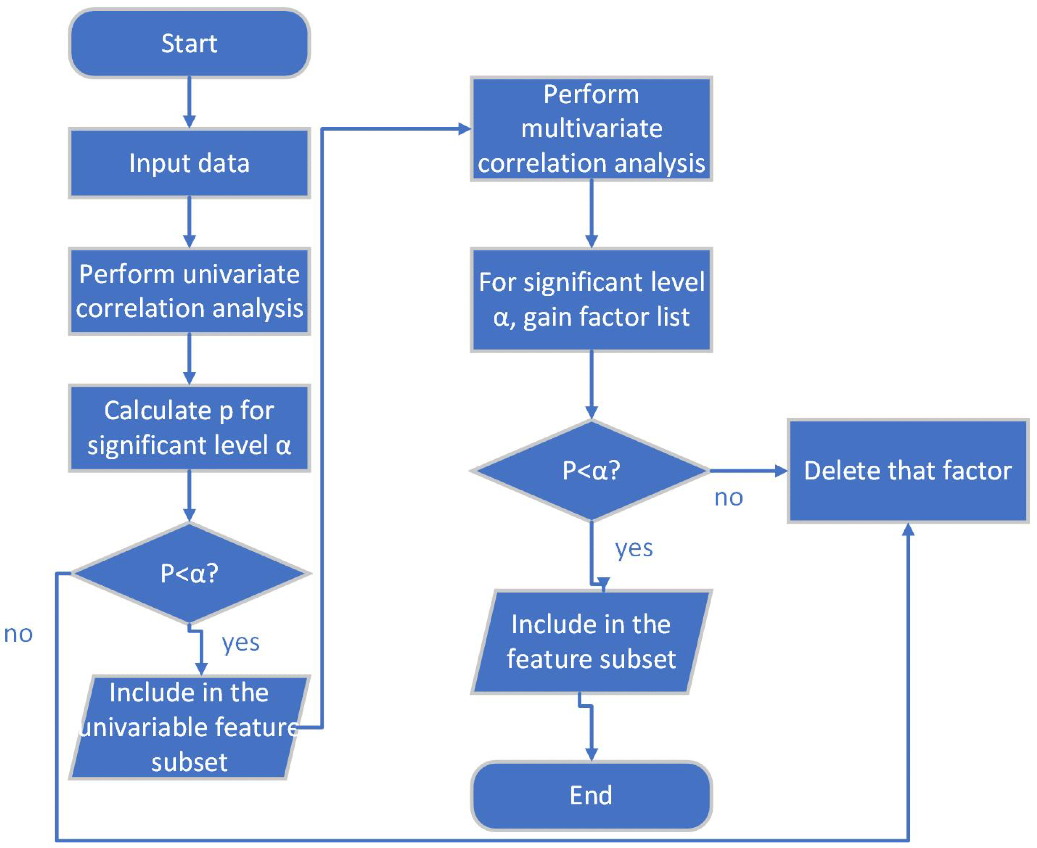
FLOWCHART

Slide 12
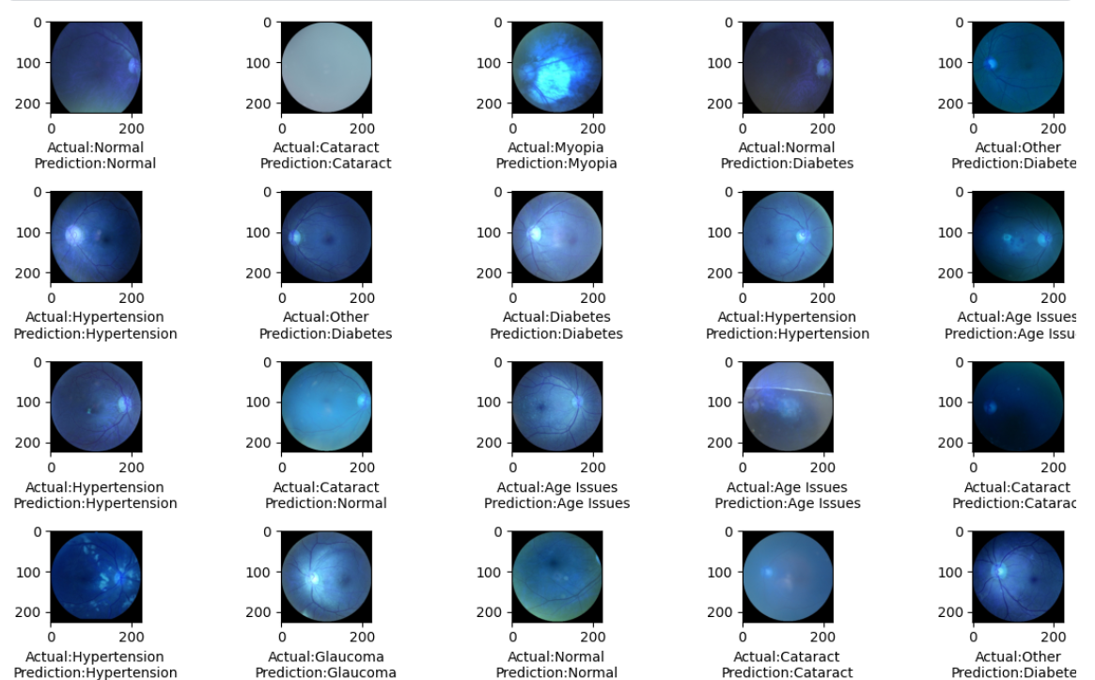
Sample Code and Screenshot of output
from numpy.random import randint
def face_layer(img):
inp = conv_layer(img)
d = Dense(128, activation='relu', kernel_initializer='random_normal’)
(inp) out = Dense(64, activation='relu', kernel_initializer='random_normal')(d)
return out

Slide 13
CONCLUSION
Pathological myopia, which is often accompanied by peripapillary atrophy (PPA), is a frequently under-estimated yet rapidly increasing global health concern.
In this paper, we have introduced a novel technique, disk difference approach, to automatically detect this ocular disease via retinal photography. The disk difference method applies a combination of variational level set and knowledge constraints to detect PPA.
The method has been validated on 40 images from the SCORM database with very encouraging results, attaining an accuracy of 95% with low false detection errors.
The high sensitivity and specificity makes this a viable approach for automatic mass screening of pathological myopia. This method is a core function within the PAMELA system.
Further work in PAMELA could include fusion of other image processing algorithms and techniques and testing on larger datasets.

Slide 14
REFERENCES
Zhang, Z., Cheng, J., Liu, J., Sheri, Y. C. M., Kong, C. C., & Mei, S. S. (2023, July). Pathological myopia detection from selective fundus image features. In 2020 7th IEEE Conference on Industrial Electronics and Applications (ICIEA) (pp. 1742-1745).
"Automated Myopia Detection Using Retinal Fundus Images" Authors: Zhang, Y., Jiang, H., Wong, D. W. K., et al. Publication: Journal of Ophthalmology, 2022.
"Machine Learning Approaches for Hypermetropia Classification from Wavefront Aberrations" Authors: Kumar, A., Swarup, S., et al. Publication: Computers in Biology and Medicine, 2023.
Tan, N. M., Liu, J., Wong, D. W. K., Lim, J. H., Zhang, Z., Lu, S., ... & Wong, T. Y. (2022, September). Automatic detection of pathological myopia using variational level set. In 2022 Annual International Conference of the IEEE Engineering in Medicine and Biology Society (pp. 3609-3612). IEEE.
Detection and Classification of ‘Myopia Epidemic’ Using Image Processing and Machine Learning to Prevent Fatal Road Accidents"2023“ https://ieeexplore.ieee.org/author/37088844930
Automatic Detection of Pathological Myopia Using Smartphone App - "2022-2023" https://ieeexplore.ieee.org/author/37086827069

